Slide 1

Lecture
on
“CBNST LAB –PMA-402”
by
Akansha Gupta
DEPARTMENT OF COMPUTER SCIENCE AND ENGINEERING
GRAPHIC ERA DEEMED TO BE UNIVERSITY

Slide 2
LAGRANGE’S METHOD

Slide 3
Introduction to Lagrange’s Method
For constructing new data points within a range of a discrete set of given data point, the interpolation technique is used. Lagrange interpolation technique is one of them. When the given data points are not evenly distributed, we can use this interpolation method to find the solution.

Slide 4
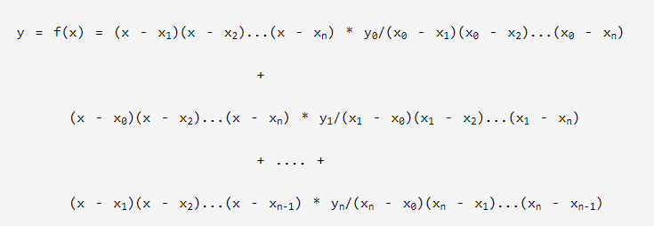
Formula: Lagrange Interpolation Method
If y = f(x) takes the value of y₀ , y₁ , y₂ , y₃ , ... , y_{n} corresponding to x₀ , x₁ , x₂ , x₃ , ... , x_{n} then

Slide 5
Algorithm: Lagrange Interpolation Method
1.Start
2. Read number of data (n)
3. Read data X_{i} and Y_{i} for i=1 ton n
4. Read value of independent variables say xp
whose corresponding value of dependent say yp is to be determined.

Slide 6
Contd….
5. Initialize: yp = 0
6. For i = 1 to n
Set p = 1
For j =1 to n
If i ≠ j then
Calculate p = p * (xp - X_{j})/(X_{i} - X_{j})
End If
Next j
Calculate yp = yp + p * Y_{i}
Next i
7. Display value of yp as interpolated value.
8. Stop

Slide 7
Complexity
The time complexity of the above solution is O(n²) and auxiliary space is O(1).

Slide 8
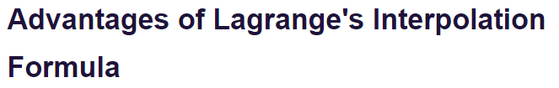
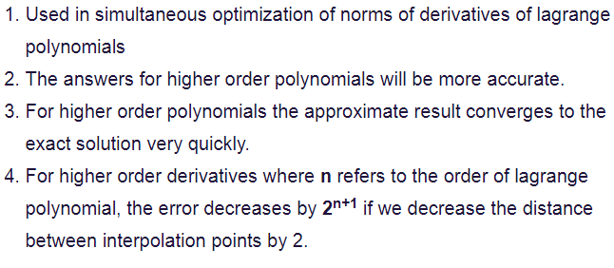

Slide 9
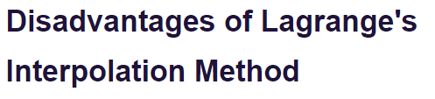
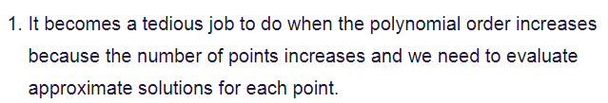

Slide 10
THANKS
https://youtu.be/AI4ncMYlKXU

